Slide 1



CALL Scotland
Passport starter
This is a suggested layout that should make it easier for you to create a Passport quickly. Each slide in this PowerPoint presentation will be a page in your Passport, once it is printed out. You can also use it as an on-screen presentation (add recorded speech, audio or animations if you like – one mouse click or switch press will turn each page (or activate an animation).
Before you do anything else, go to ‘File menu’ and ‘Save As’, to save this file and keep it as a blank template for re-use. (Save file as Template if you know how or just name it ‘blank’ if you don’t yet).
Once you have read these instructions (print them out if you like, Slide 1) you should delete this slide/page so that it is not included in the Passport (click to select it in the left side menu then press backspace/delete) and again Save As with the name of your particular Passport.
There are some symbols and ‘starter text’ lines to give you ideas but if you don’t want to use them you can move (click & drag), resize, delete or change them and/ or insert your own. To add new text, you may need to go to ‘Insert’ Menu, Textbox then click in it and write.
To re-order pages, just click, hold and drag the slide showing in the left-hand window to the position in the series that you want it to be in.
If you add, delete, or move pages around, remember to alter the page numbers and Index page numbering to match!
Also date each page by typing the date into the footer box. Go to ‘Insert – Header & Footer – select Footer and edit text.
To alter page numbers or other things in the footer box, go to ‘Insert - Header & Footer - Date & Time / Fixed box and type in the change’. Then click ‘Apply’ (each page to be done separately, as date will vary from page to page).
Please DON'T just bash out lots of Passports that all look the same
– personalise, personalise, personalise!
Have fun!
https://www.communicationpassports.org.uk

Slide 2

Copyright
This Passport starter is ©2025 CALL Scotland.
You are welcome to use and copy it freely for use by people with disabilities, providing you:
do not claim it was designed by you and take reasonable opportunities to give CALL Scotland credit for it, and
do not sell it or any materials that include this Passport.
Created by CALL Scotland 2025 with Boardmaker. The symbols used in this CALL Scotland Passport starter are Picture Communication Symbols (PCS).
PCS is a trademark of Tobii Dynavox LLC. All rights reserved. Used with permission.
If you have this software, you are entitled to use these symbols and pictures. You should always include the copyright statement as above on any printed copy of the Passport that uses the symbols, if it is going outside the home / school / centre where the software is.
If you do not have this software, you should delete these symbols and pictures and insert instead photos, graphics of your own, non-copyrighted clip art etc.

Slide 3
This book is about me!
My name is
Insert photo etc here.
Please read!
This book will help you to get to know me and how I communicate.

Slide 4
Page Index
1. All about me
2. You need to know
3. My Family
4. My Friends
5. Special people, special things
6. Things I like to talk about
How I communicate
How I communicate (2)
9. You can help me communicate
10. Fun things I like to do
11. Places I like going
12. Things I don’t like
13. I’m working on this...
14. Help!
15. Eating and Drinking
What’s my eyesight/ hearing like?

Slide 5

All About Me!

Slide 6

You need to know...
1. Delete & add your own text
2.
3.
4.

Slide 7

I love my Family
I like to talk about them, so you need to know who everybody is!

Slide 8


My Friends

Slide 9

Special People Special Things

Slide 10

Things I like to
talk about

Slide 11
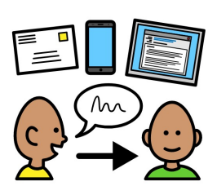
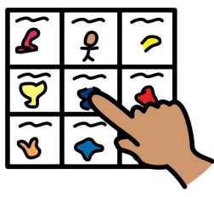

How I Communicate (1)
I

Slide 12



How I Communicate (2)
Delete this & add your own text

Slide 13
You can help me to communicate
Please DO
give me plenty time
Please DON’T
ask me more than one question at a time

Slide 14


Fun Things!
I like

Slide 15


I like going to..
Swimming (I’m brilliant!)

Slide 16

I can’t stand it!
Delete and add your own text here
So don’t say you haven’t been warned….

Slide 17

I’m working on this….

Slide 18
Help me please!

Slide 19


Eating and Drinking

Slide 20

What’s my sight/ hearing like?

